Slide 1

Bill & Aimee’s Excellent DevOps Journey
How a Not-for-profit Corporation Adopted DevOps
Bill Donaldson
wbd@mitre.org
Aimee Bechtle
abechtle@mitre.org
Approved for Public Release; Distribution Unlimited. Case Number: 14-3400 ©2014 The MITRE Corporation. ALL RIGHTS RESERVED.

Slide 2




What is MITRE?
MITRE is a not-for-profit
organization that operates Federally Funded Research and Development Centers

Slide 3




Who Are We?
Dev
Ops
I’m Aimee
I’m Bill
Road Trip!

Slide 4
The Starting Line
JAVA, .Net
ANT, Maven
Subversion (SVN)
Oracle, SqlServer, MySQL
RHEL, Windows 2008
Avg Cycle Time = 15 days (30 mins – 486 days)
# Deploys/yr = 2579
Processing
Paperwork
People

Slide 5


In The Beginning – Aug 2009
They are slowing me down!
The service
we provide
is great!
Dev
Ops

Slide 6


Confronting the Chasm – May 2010
24 hour SLA is 23.5 hours too long!
Huh?
Dev
Ops

Slide 7
Bridging the Chasm – Aug 2010
Let me
show you how
this could work.
OK!
a
Dev
Ops

Slide 8

Defining Success – Fall 2010
Let’s define
Acceptance
Criteria !
DevOps

Slide 9

Acceptance Criteria
MITRE
Single command to build app given an SVN revision #
Single command to deploy to environment given an SVN revision #
Build once. No development tools utilized on target environment.
Deploy to test environment is self-service and can be done by any user without handoffs (no SA, DBA) or additional passwords
Deploy to PROD is done by release team without handoffs (no SA, DBA)
Prior to deploying validates compliance with SONAR quality reports and code coverage
Can determine what SVN revision is deployed in each environment, by who and when
In PROD, on error or abort application is restored to prior state
No additional instruction documentation is needed.
In phase 1, utilize existing request system for approvals
System validation is manual and outside of scope
I can live
with that.

Slide 10

The Launch – May 2011
DevOps
DevOps
Everyone on Board!
Build and Release
Engineer
Sys
Admin
Java, .NET Developers
DBA

Slide 11

Implementation – (5/11 to 6/12)
DevOps
DevOps
Are we there yet? Are we there yet?

Slide 12




Course Correction – April 2012
Got Training
Brought in Expertise
Freed Up Resources
A New Plan!

Slide 13
Our DevOps Solution– June 2012
1
Developer develops commits code to repository
Commits automatically trigger builds
2
Depending on environment developer or Release Engineer deploys build
3

Slide 14



Scaling Up – June 2012
Its working
Woo Hoooo!

Slide 15
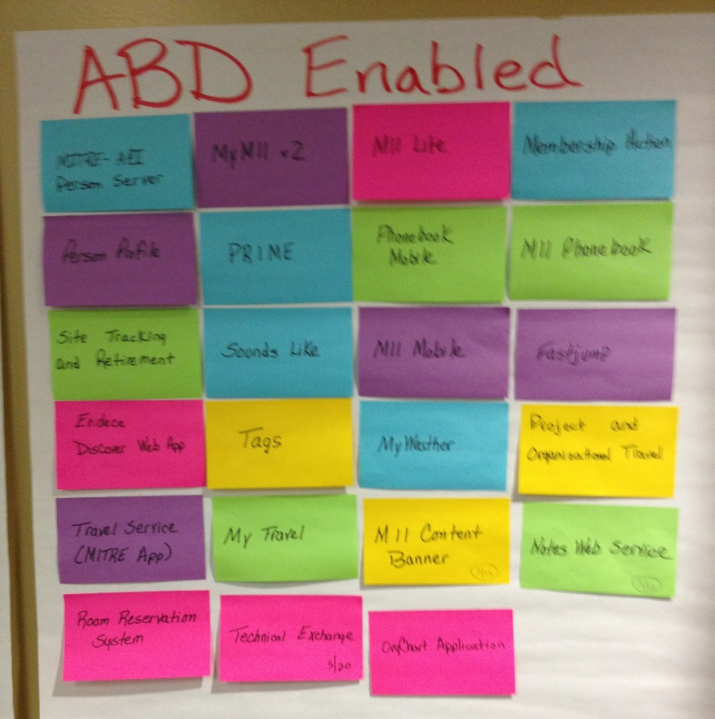
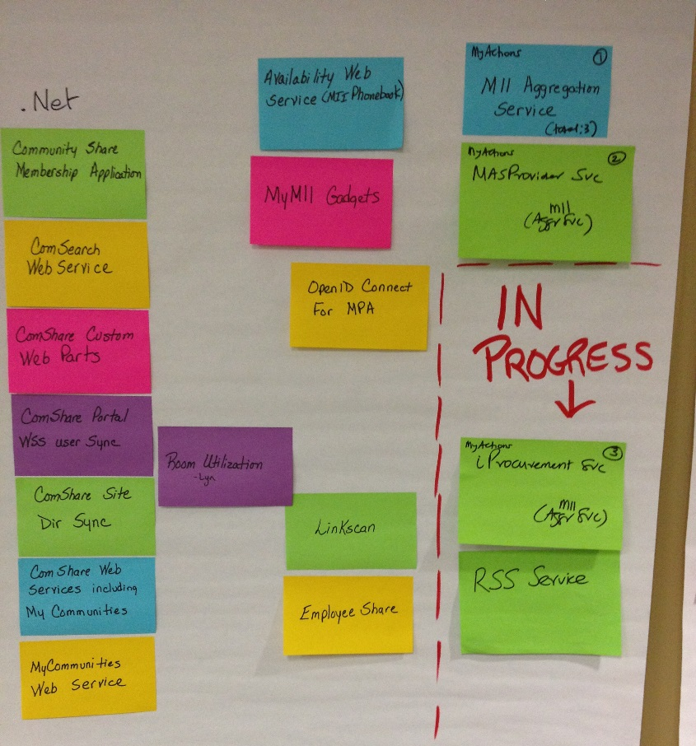
Visible Tracking

Slide 16
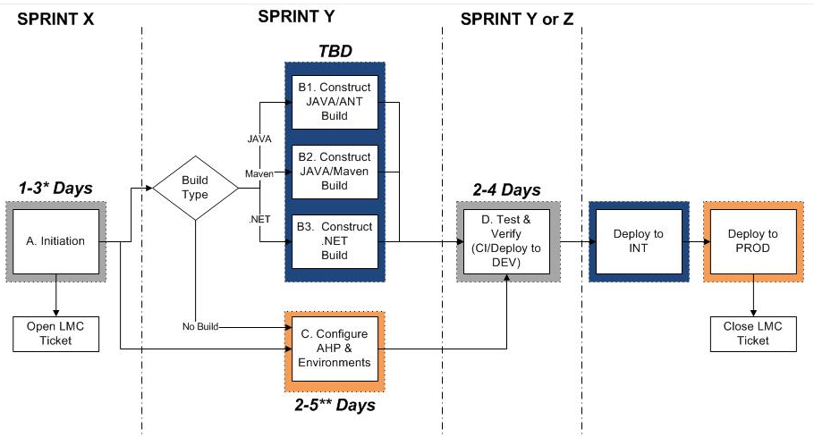
Recipe For Onboarding

Slide 17
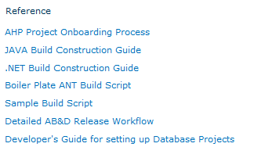
Guides and Samples

Slide 18
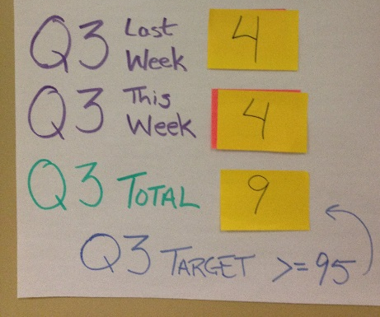
Marketing
Visible Metrics
Water cooler Talk
Formal briefings to
CIO and Senior Mgt
Snackfest

Slide 19
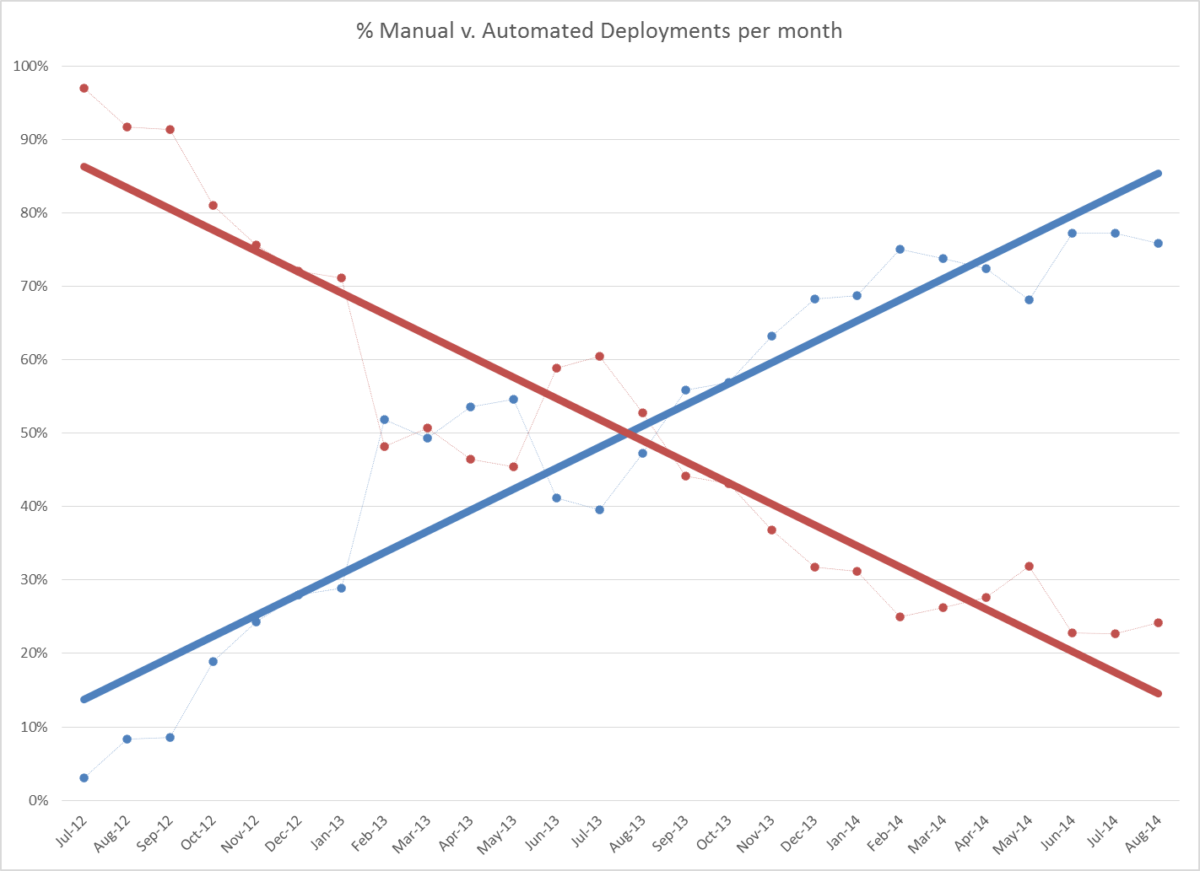

The Results
68 applications in system
Multiple Platforms
ANT, Maven, Gradle
SVN, GIT
JAVA, .Net, NodeJS
Oracle, MySQL, SQL Server, MongoDB
Avg Cycle Time = 9 days (-40%) (range 2 mins – 483 days)
~75% of deploys are automated
# Deploys/year = 3555
Auto = 2665
Manual = 890 (-65%)
38% Throughput Increase
Freed up 2.5 deployment staff

Slide 20
The Future: Continuous Delivery
a
DevOps
a
DevOps
Let’s do it again
Pleeease!
Ops
Automation
Engineer
Build & Release
Engineer
Sys
Admin
Java, .NET Developers
Test
Automation
Engineer
DBA

Slide 21

Bill & Aimee’s Excellent DevOps Journey
Anyone can do it
Know where you want to go and why
Patience - it takes time for change
Education, education, education
Use Agile (minimal product, iterations, product demonstrations)
May ’11:
Success Defined, Launch
Jun ’12:
Success!
Today:
Results
July ’10:
Confront
Apr ’12:
Got Help
Aug ’09:
Old Process

Slide 22
What We Need Help With
Changing skillsets and mindsets to:
Support infrastructure and test automation
Break up silos and organize into cross-functional delivery teams
Incorporating ERP and large COTS (or non-typical, non-web) applications into a DevOps model

Slide 23
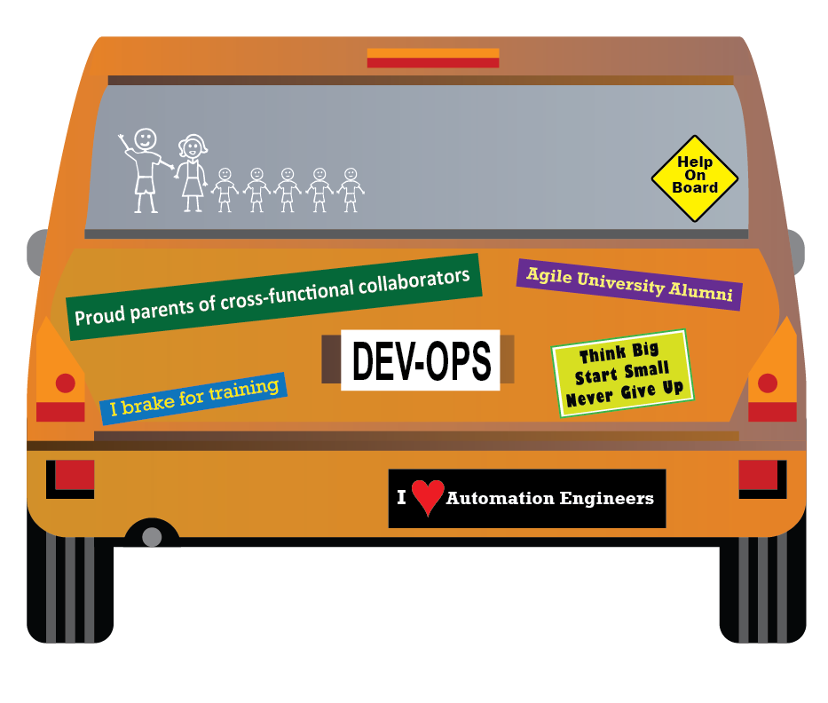
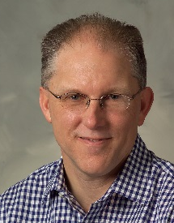
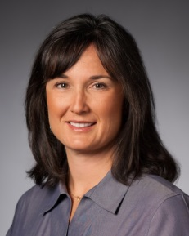
Thanks!
Bill Donaldson
wbd@mitre.org
@wbdonaldson
Aimee Bechtle
abechtle@mitre.org

